Slide 1








become a data wizard
Data Analysis with RStudio

Slide 2
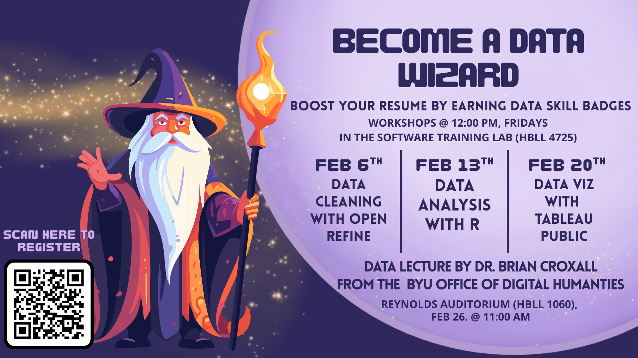

Slide 3


What is RSTUdio?
R is the engine (the language), and RStudio is the dashboard (the interface).
User-Friendly: Organizes code, plots, and files in one place.
Safe: Working in R doesn't change your original CSV file; it creates a new version in your computer's memory.

Slide 4

Goals
Navigate the RStudio Interface
Understand the three core data types
Use Assignment and Comparison operators
Learn to upload and manipulate data frames
Use basic dplyr functions to transform data

Slide 5
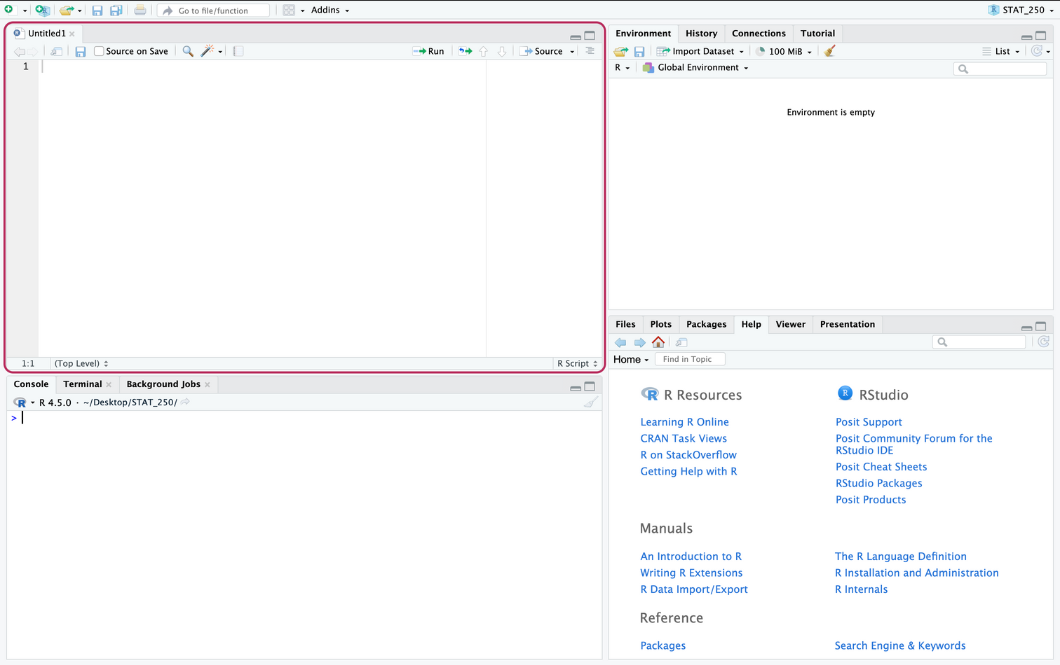
RStudio Interface
Source editor

Slide 6
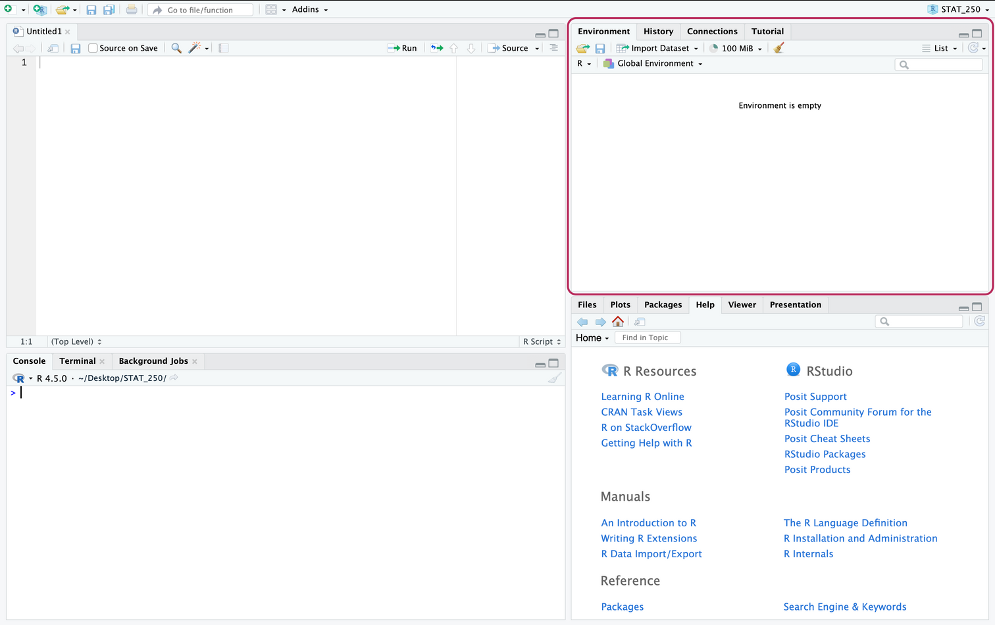
RStudio Interface
Environment

Slide 7
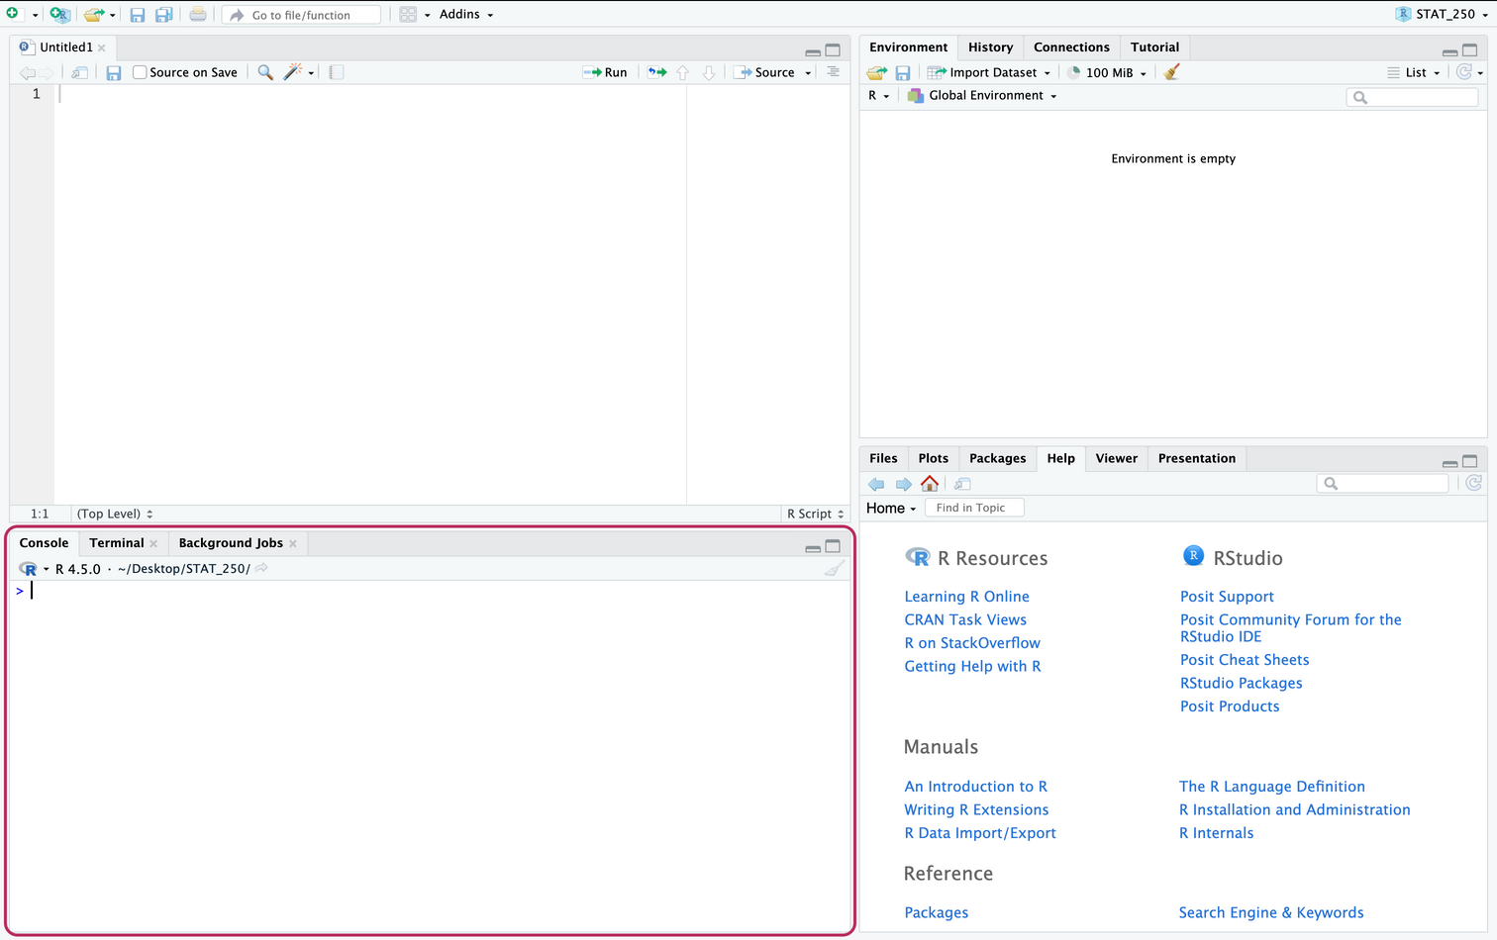
RStudio Interface
Console/Terminal

Slide 8
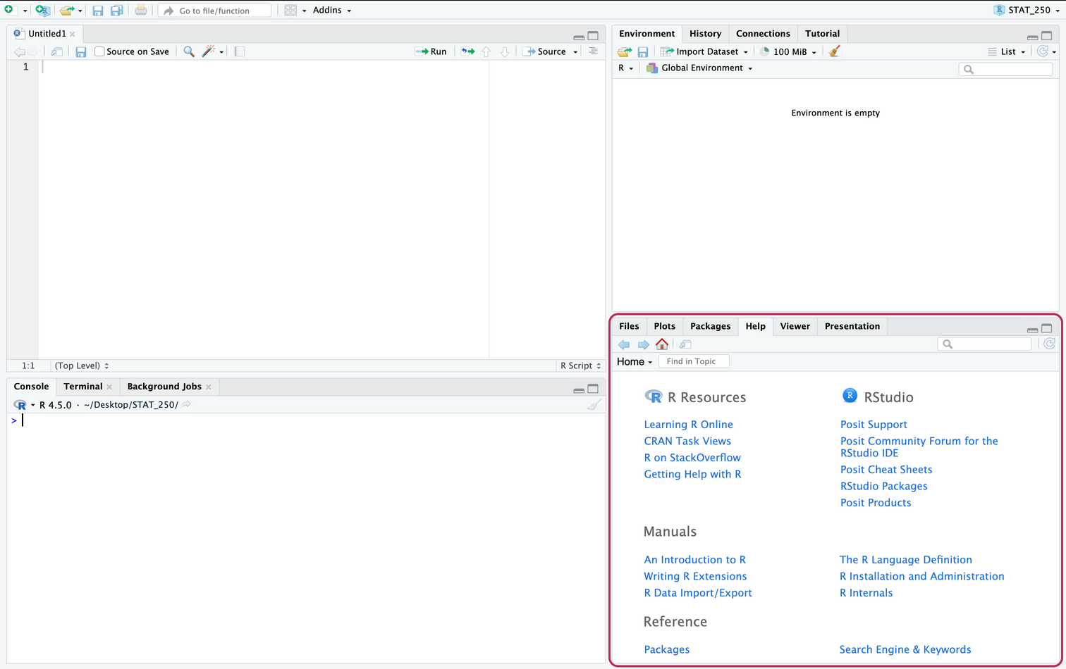
RStudio Interface
Files/Help

Slide 9

Link for Files
https://tinyurl.com/2msbbhtj
(if you haven’t received an email with a link)

Slide 10

Extra Resources
R for Data Science (2e) - free digital book all about R!
Many online R courses for free!
BYU courses (STAT 250, etc)

Slide 11
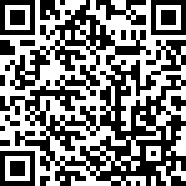

Thank you!

